Slide 1
Giraffe recognition Project
CS 526
Jiapeng Zhang, Xiao Liu, Chengyuan Deng
Mentor: : Prof. James Abello

Slide 2
Project Outline
Motivation
System Overview
Mockup Interface
System Architecture
Division of Labor &Project Timeline
Future Work
References/Resources
Acknowledgements

Slide 3
MOTIVATION
Our inspiration comes from the ‘Giraffe Project’ guided by Prof. Lesk and Kristina.
There are millions of pictures captured in San Diego Zoo, the underlying goal is to use image processing technology to count and monitor giraffe populations.
Based on the underlying goal, our goal is to develop a system that can identify the pictures whether there are giraffes in them.

Slide 4
System overview
Data Collection
The millions of pictures taken by more than 100 cameras in San Diego Zoo, Kenya.
These pictures may contain different animals such as giraffes, zebras, baboons, cattle, or even human beings.
Only the pictures which contain giraffes are useful to us.

Slide 5
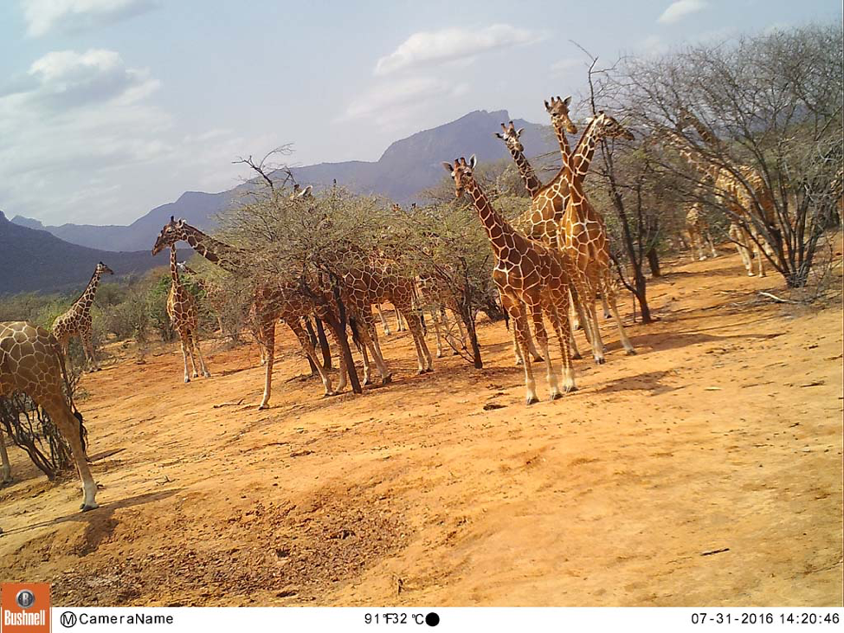

Slide 6
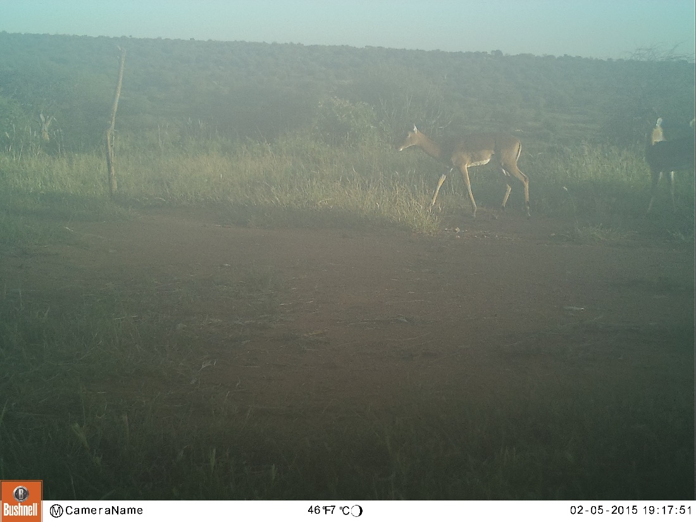
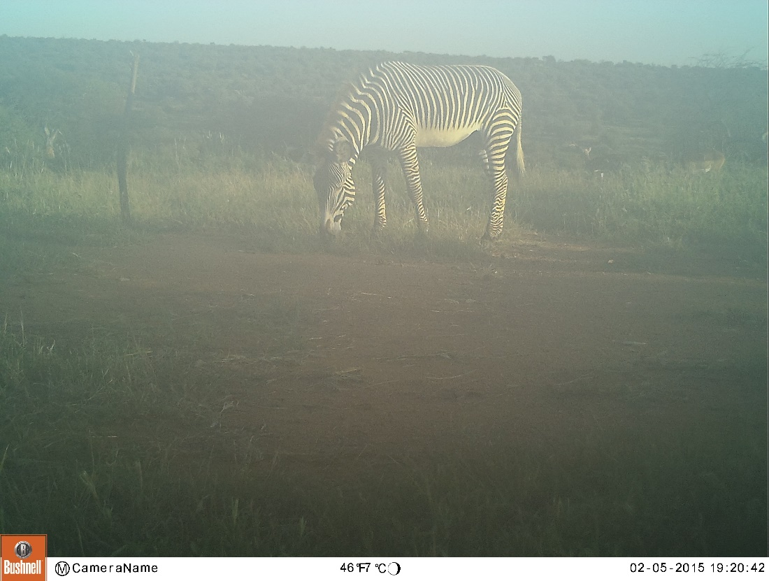
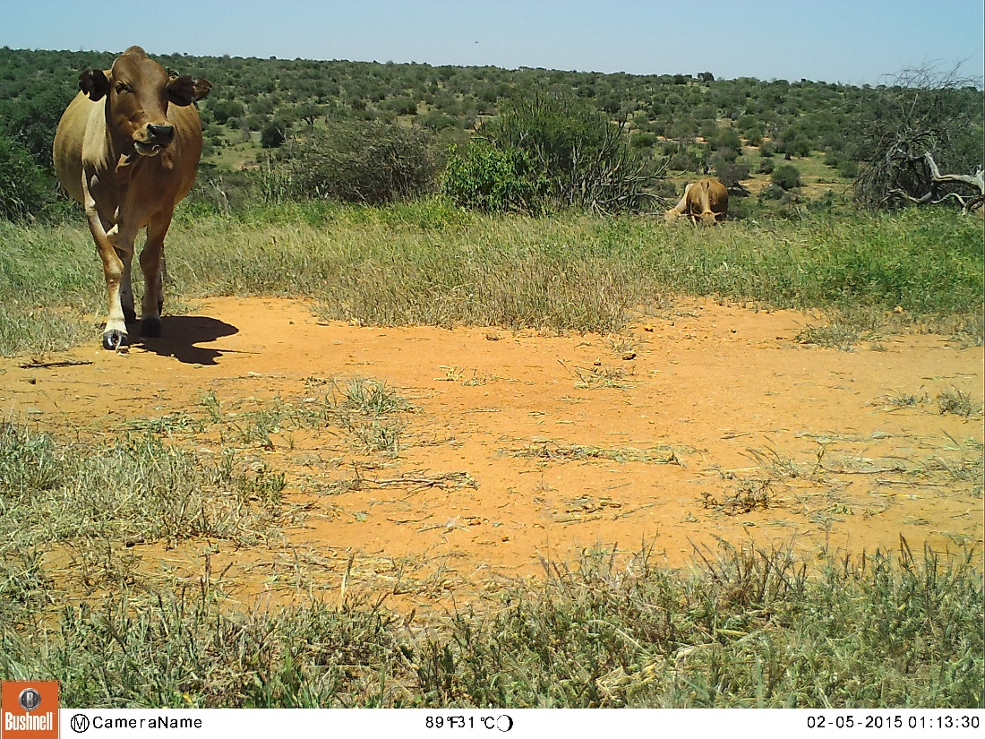
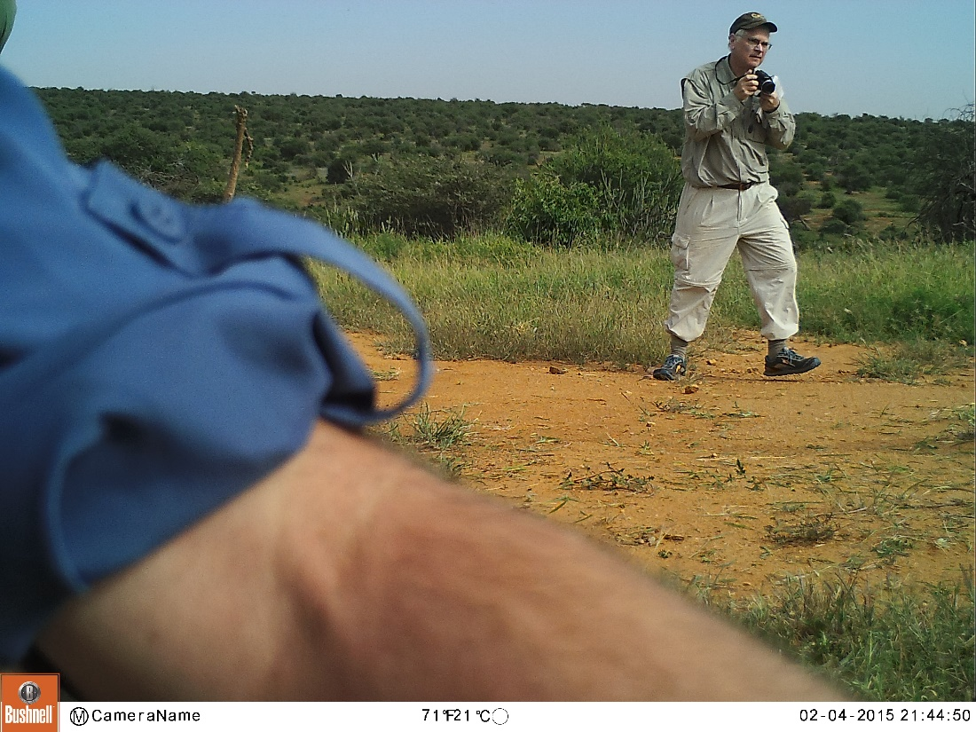

Slide 7
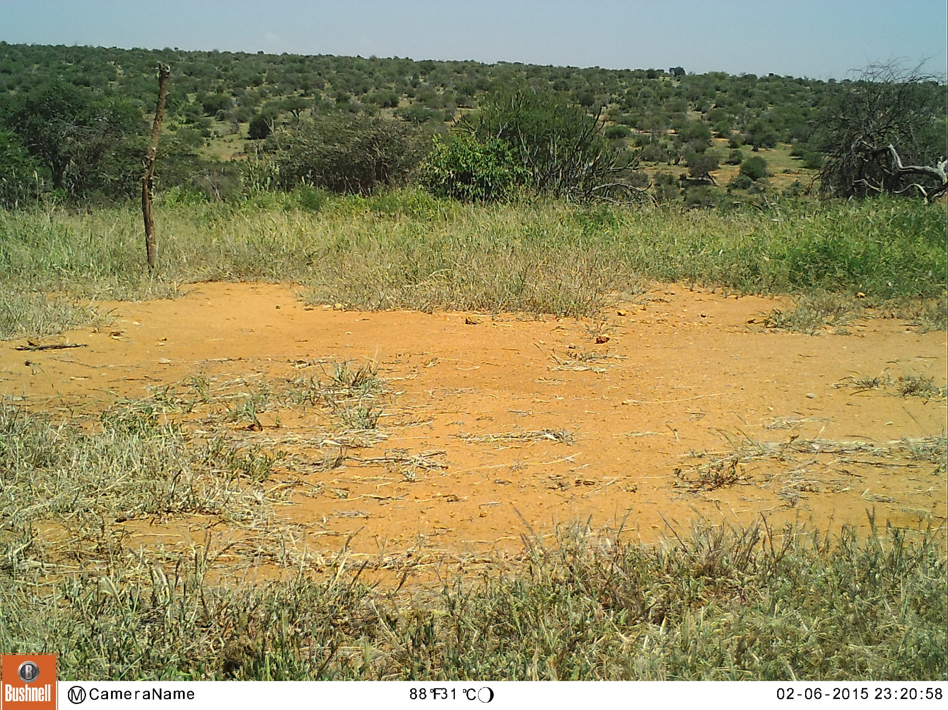

Slide 8
System overview
Implementation Steps
Sort out the useful pictures.
Use these pictures to train machine learning models to identify whether there are giraffes in these pictures.
Use the test set to modify or rebuilt our models until we get a decent test result.
Build the user interface which enable users to upload pictures, and write scripts to enable the system to identify if there are giraffes in these pictures.

Slide 9
System overview
Tentative Ideas of Model Design
Given the high performance of pattern recognition on computer vision, we plan to implement a Convolutional Neural Network(CNN).

Slide 10
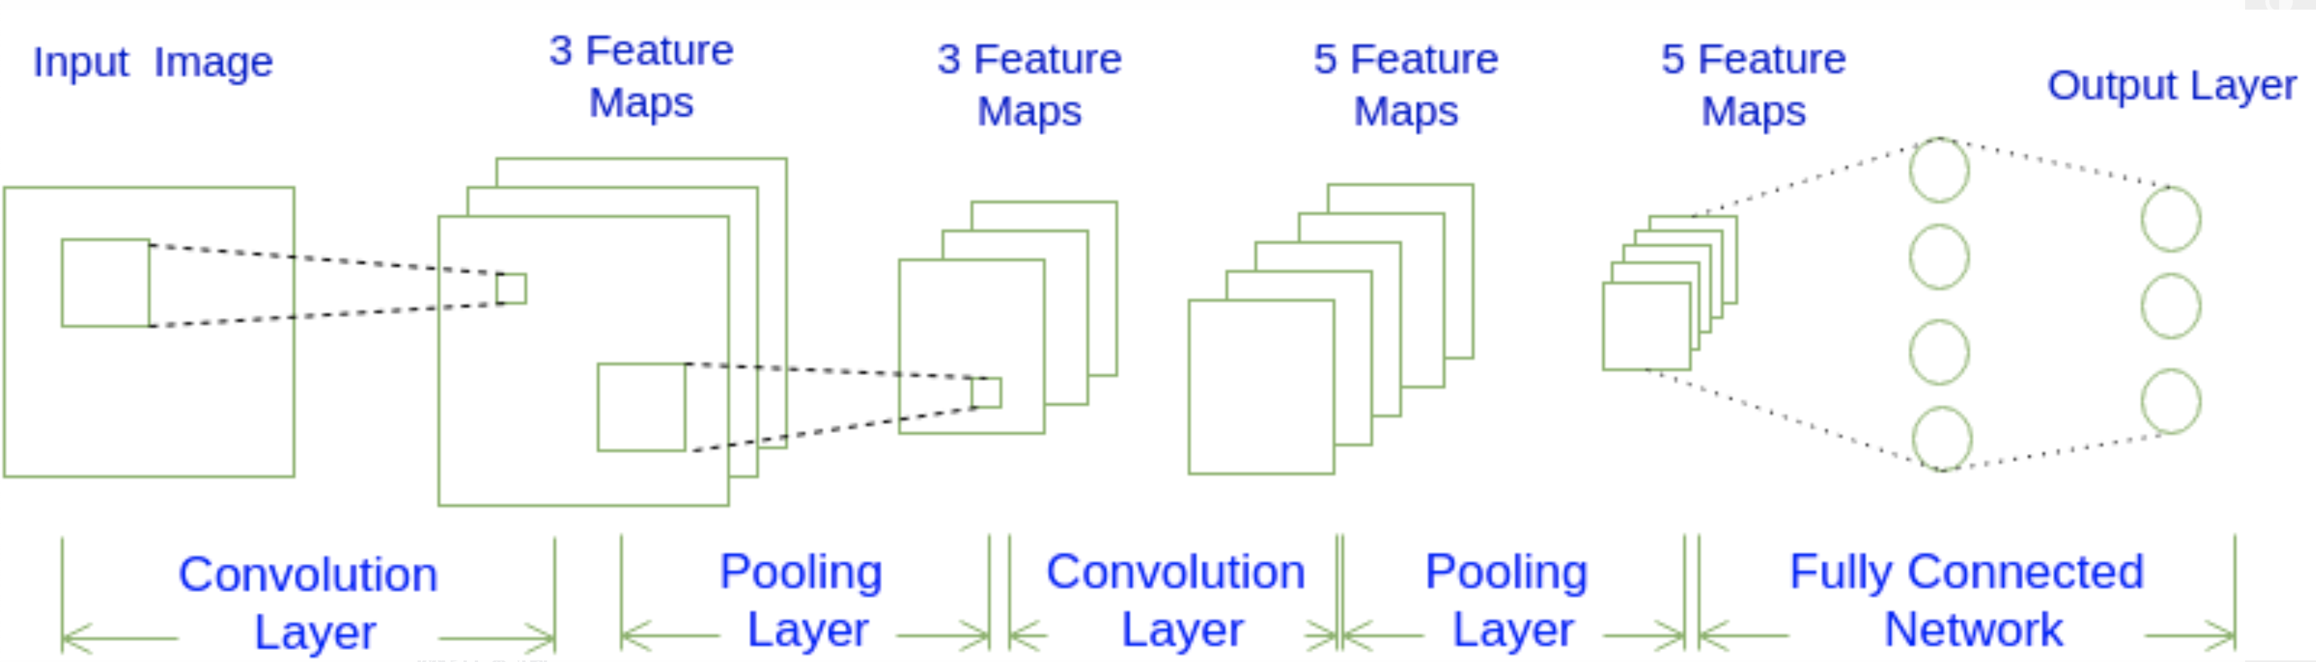
A tentative idea of CNN model

Slide 11
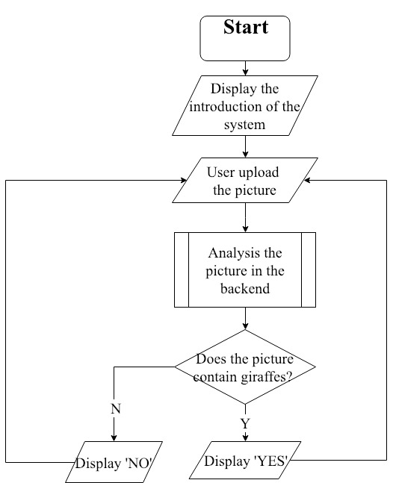
System overview
Flow Diagram

Slide 12
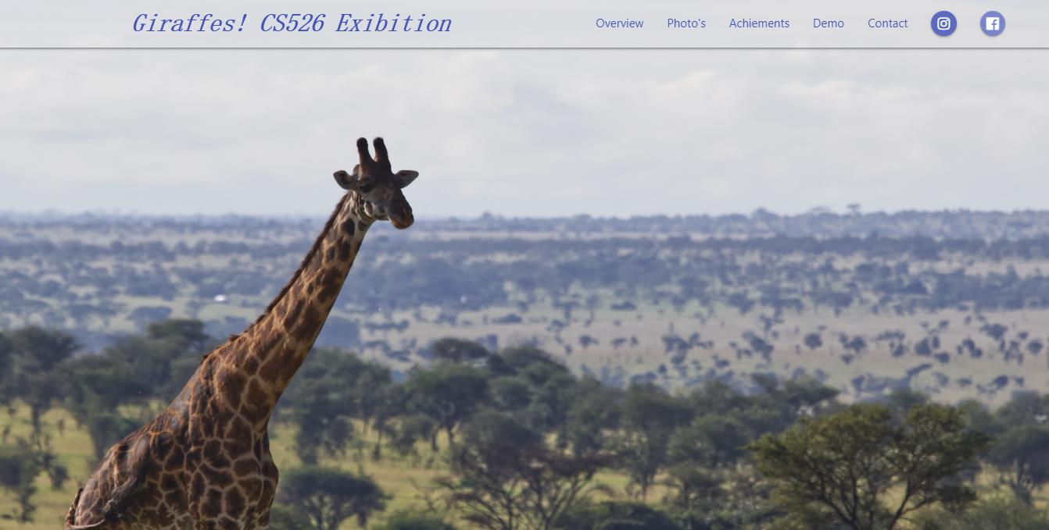
Mockup interface
Welcome page

Slide 13
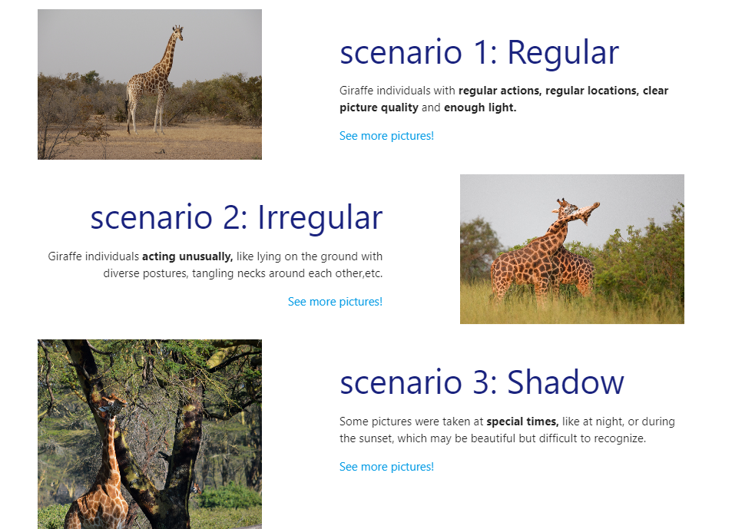
Mockup interface
Introduction of scenarios

Slide 14
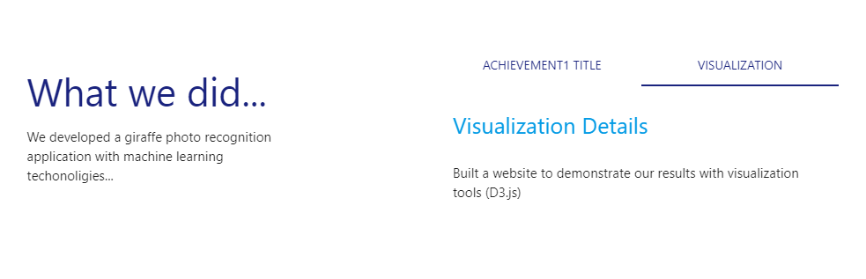
Mockup interface
Achievement Introduction

Slide 15
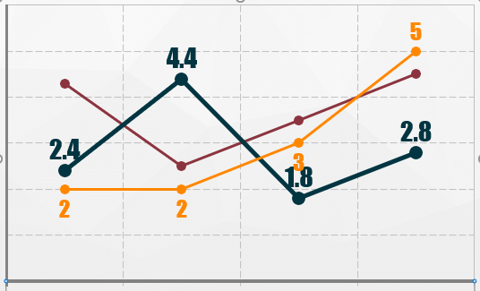
Mockup interface
Variation of giraffe numbers on each camera
Visualization

Slide 16
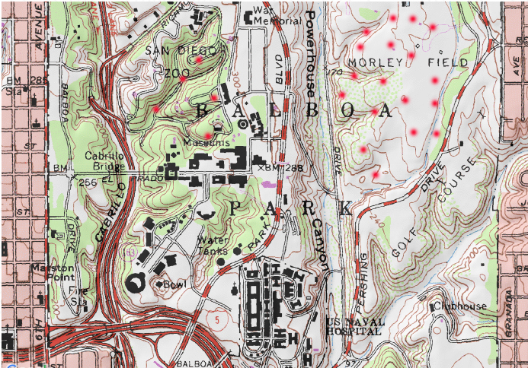
Mockup interface
Floating tendency based on camera locations
Visualization

Slide 17
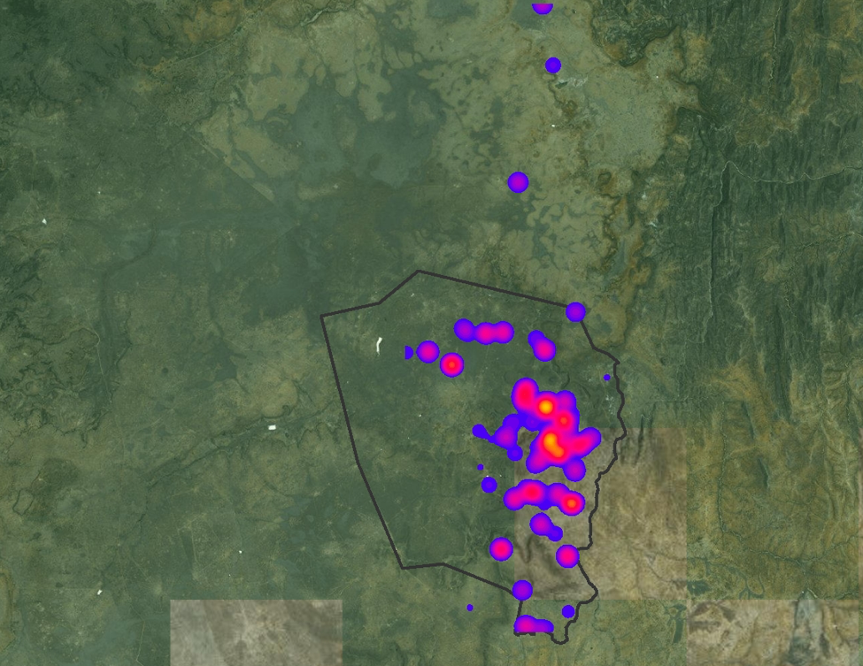
Mockup interface
Giraffe population thermodynamic distribution
Visualization

Slide 18
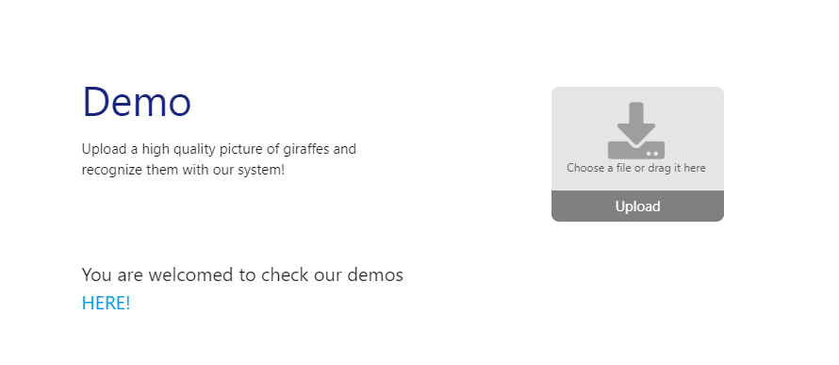
Mockup interface
Upload the picture here.

Slide 19
System Architecture
users
INTERACTIVE
HTML
CSS
JavaScript
Web Page
VISUALIZATION
Linux
Apache
Python
Server
Images
ANALYSIS
Data
Mysql Database

Slide 20
Division of Labor &Project Timeline
W1 - 3: Decided & Wrote the project proposal.
W4 - 6: Design Algorithms & Train Models
W7 - 9: UI design & Webpage development
Chengyuan Deng (Front web page)
Xiao Liu(Back end scripts)
Jiapeng Zhang(Algorithms and models)
W8 -10: Integration & Write-up

Slide 21
Future Work
The project could be expanded by determining other class projects that will benefit from our group work. They are:
Computer Vision
Machine Learning
Artificial Intelligence
We hope to recognize pictures with multiple animals and count them.

Slide 22
Future Work
We would eventually like for our project to become open source where users can interact differently by sharing their opinions and codes and building a community together.
We are expecting a future achievement of our application that we could eventually locate the giraffe and count the numbers together with the environmental parameters(e.g. temperature, humidity), so that we can track the status and number of giraffes and take necessary actions to protect them from endanger.

Slide 23
References
https://institute.sandiegozoo.org/science-blog/wildwatch-kenya-preliminary-results-field
http://www-cs.ccny.cuny.edu/~wolberg/capstone/opencv/LearningOpenCV.pdf
https://docs.fast.ai/
RESOURCES
OpenCV
FastAI
HTML/CSS
jQuery
Python (Django)

Slide 24
Acknowledgements
We would like to thank Prof. Abello for inviting Prof. Lesk to introduce this project, and much appreciate to M.Lesk and Kristina Plazonic for guiding this project and providing us plenty resources for us to do research.

Slide 25
Thank You!

